Slide 1




PORTFOLIO
DESIGN
STUDENT NAME:NAVEENKUMAR P
NMID : 0B7218348B94CFDBF6C4AF442469D504
DEPARTMENT : BSC COMPUTER SCIENCE
COLLEGE : CHIKKANNA GOVERNMENT ARTS COLLEGE /
BHARATHIYAR UNIVERSITY

Slide 2


AGENDA
1.problem statement
2. Project overview
3. End Users
4. Tools and Technologies
5. Portfolio design and Layout
6. features and functionality
7. Results and Screenshots
8. Conclusion

Slide 3
1. Problem Statement
The gaming industry is highly competitive, requiring developers to showcasecreativity, technical expertise, and problem-solving skills.
Many developers struggle to present their projects in a structured,
engaging, and professional way.A dedicated portfolio is essential to demonstrate capabilities to recruiters, studios, and collaborators

Slide 4

2. Project Overview
Development of a Game Developer Portfolio Website to showcase skills,projects, and design philosophy.Highlights coding ability, game mechanics, 3D/2D design, and storytelling.
Provides interactive demonstrations and downloadable content for employers/ clients.

Slide 5
3.End Users
Recruiters / HR Managers - Evaluate technical expertise and creativity.
Game Studios & Companies - Assess portfolio for hiring/freelancing.
Fellow Developers & Collaborators Networking and idea sharing.
Gamers/Community - Explore projects, play demos, and give feedback

Slide 6
Tools and Technologies
Game Engines: Unity, Unreal Engine,Godot.
Programming Languages: C#, C++, Python, JavaScript.
Graphics Tools: Blender, Photoshop, Illustrator.
Version Control: GitHub

Slide 7
Portfolio Design and Layout
Show screenshots of your portfolio website or resume layout.
Highlight sections: About Me, Skills, Projects, Contact.
Use clean UI/UX design with gaming-style icons.

Slide 8
Features and Functionality
Gameplay mechanics (jumping, shooting, puzzle-solving).
Multiplayer or Single Player.Cross-platform support.
Special features (Al enemies, physics, storyline).

Slide 9
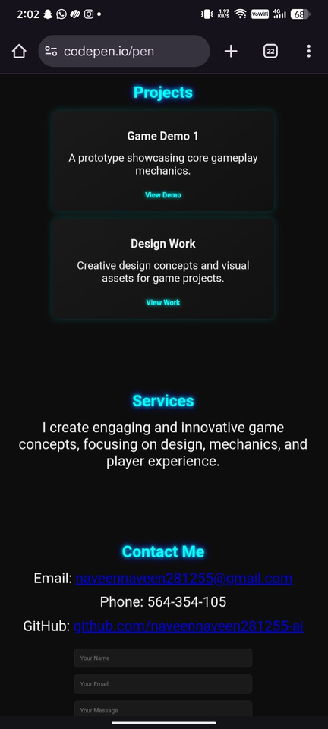
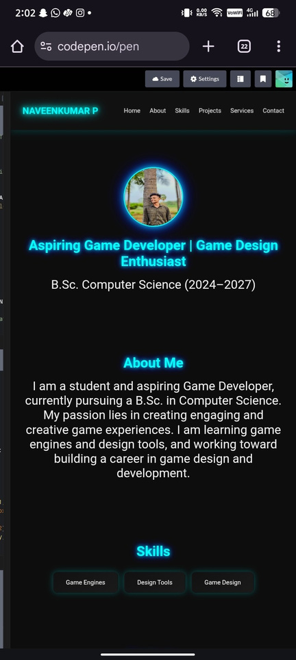
RESULTS AND SCREENSHOTS

Slide 10


CONCLUSION
A well-designed portfolio bridges the gap between a developer's skills and industry opportunities.
Demonstrates both technical expertise and creativity in game development.
Enhances visibility, career growth, and potential collaborations.
Next step: Continuously update with new projects and innovative game ideas.

Slide 11
THANK YOU...

